Slide 1
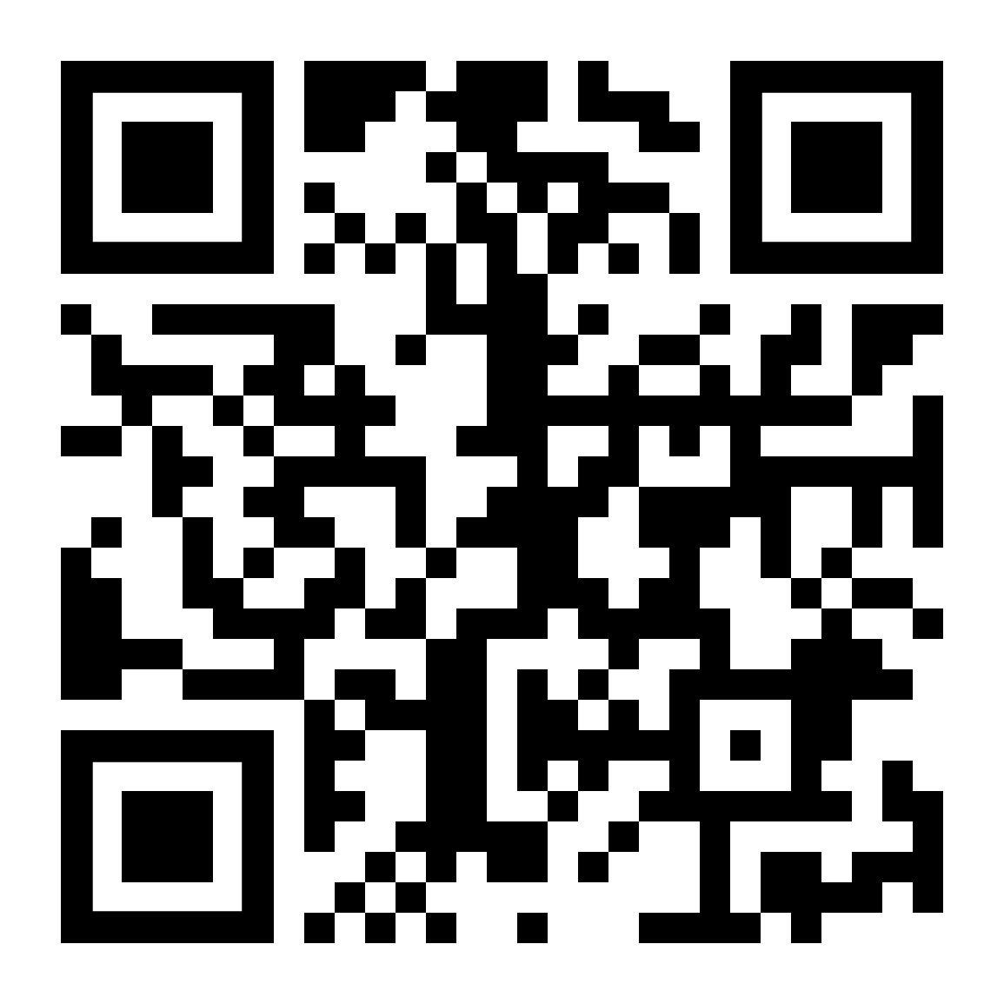
Go to
https://ecoracing.co/user/page/1x3x
right now and buy lots of virtual balloons for Myxxcharity
Everest Base Camp
Virtual balloon race
Launch noon
14th September
£3

Slide 2
Everest Base Camp
Virtual balloon race
Launch noon
14th September
£3
Go to
https://ecoracing.co/user/page/1x3x
right now and buy lots of virtual balloons for Myxxcharity

